Slide 1
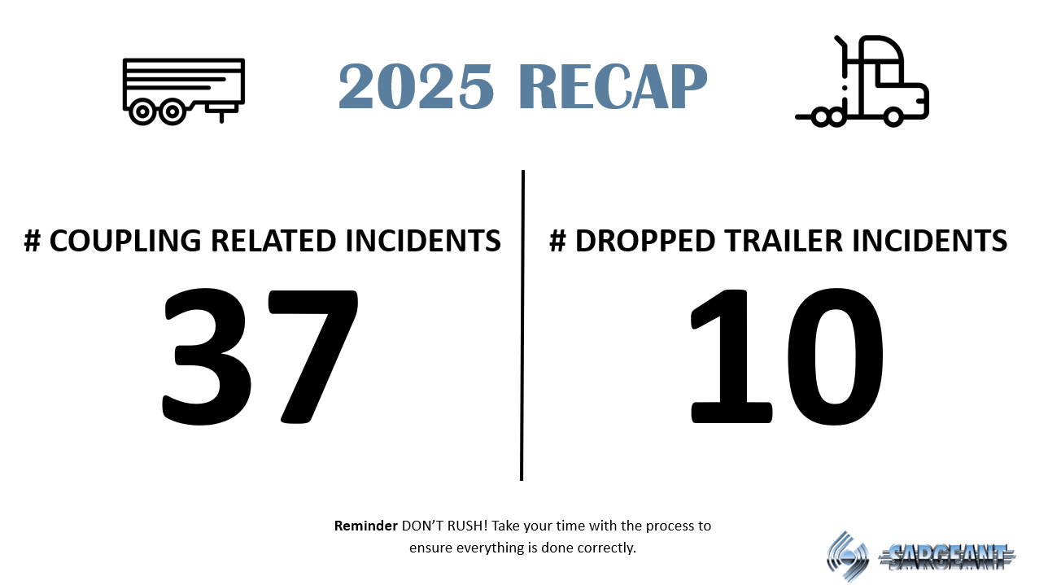



2025 RECAP
37
10
# COUPLING RELATED INCIDENTS
# DROPPED TRAILER INCIDENTS
Reminder DON’T RUSH! Take your time with the process to ensure everything is done correctly.

Slide 2

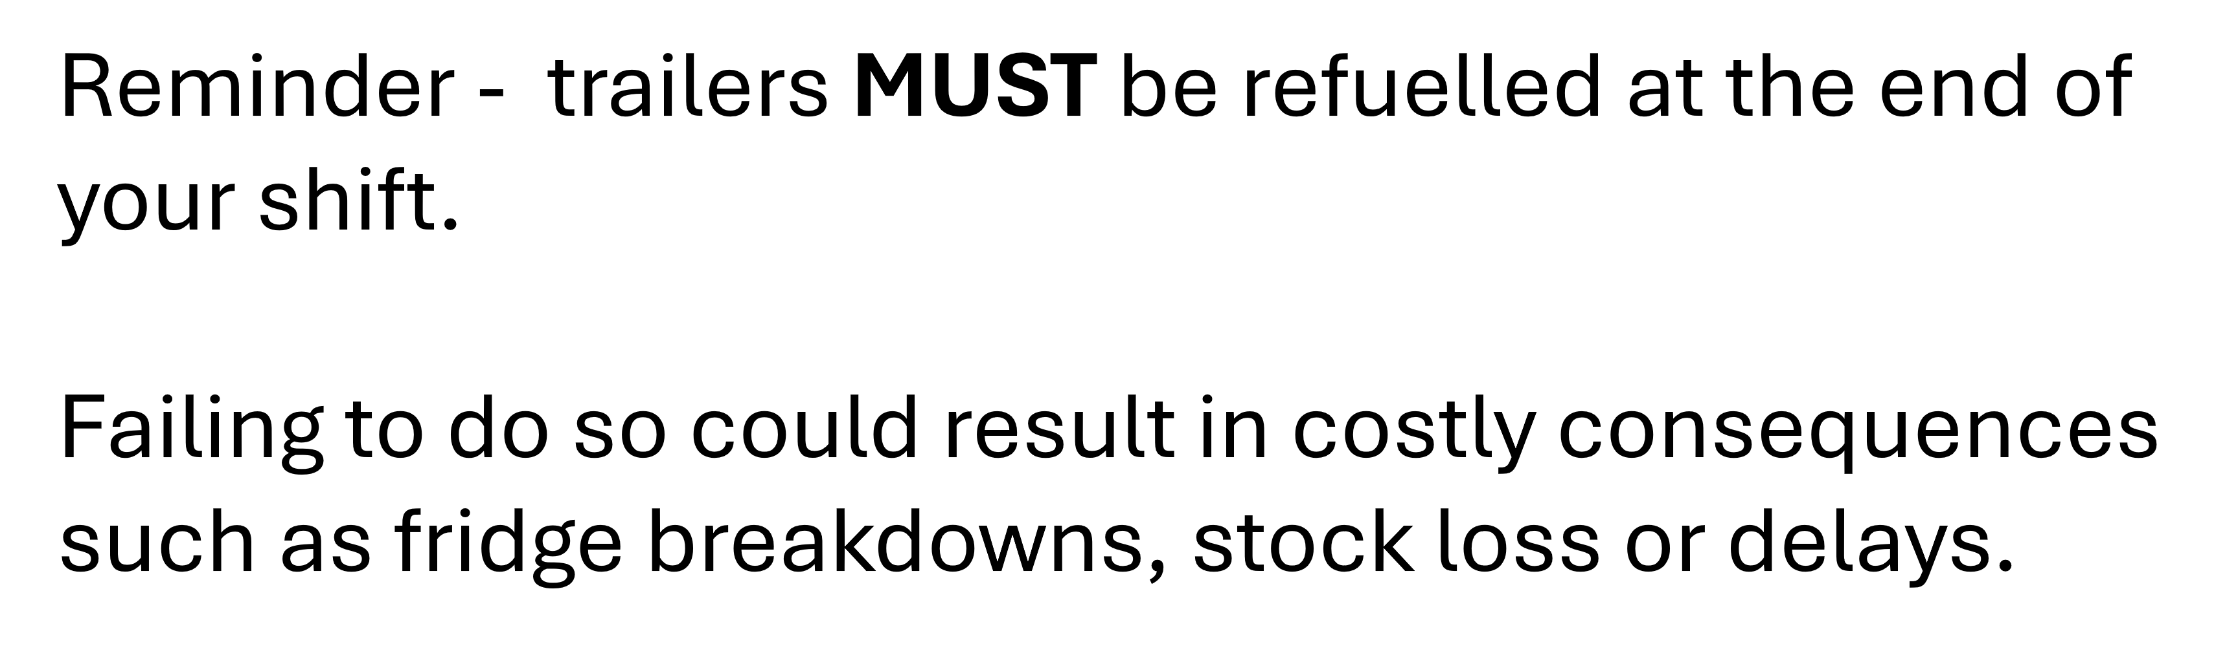
TRAILER REFUELLING

Slide 3
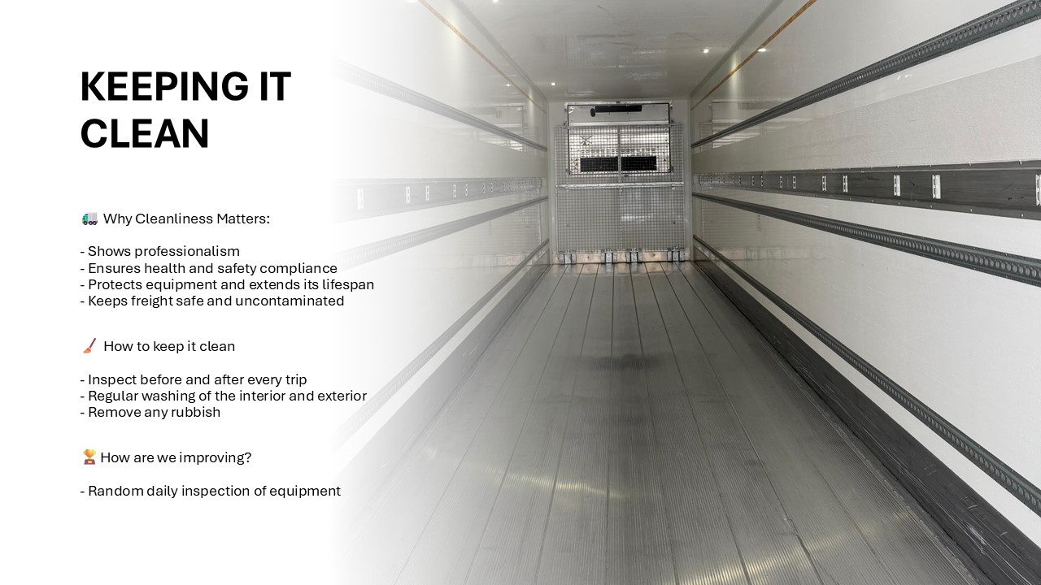

Slide 4
REFER A MATE!
We’re actively hiring for all depots – please let us know if you know anyone that could be great for the role!

